Slide 1


INTRODUCTION TO MACHINE LEARNING LESSON 1 HANDS ON
By: Ebone’ Smith

Slide 2
BEFORE WE DO ANYTHING YOU MUST…
import seaborn as sns
from sklearn.utils import shuffle
IMPORT ALL YOUR PACKAGES

Slide 3
IMPORT YOUR DATASET
You MUST ADD your dataset in order to do your work.
For this assignment we are using Diamonds
Diamonds = shuffle(sns.load_dataset('Diamonds'))

Slide 4
WHAT IS THE ASSIGNMENT???
In this Hands-On exercise you will create a project which will require you to take data, clean it so that it's usable, and finally create a linear model to predict unknown data. This Hands-On project should be completed using the browser for downloading data and Python for plotting and modeling the data.
Use the following variables to predict the price of diamonds:
carat
cut
color
clarity
You will need to utilize the train_test_split() method as well as LinearRegression() to train and test your algorithm. Then, leverage your knowledge of cross-validation and Python programming to cross-validate the work you did. Note the variation in model accuracy once you have cross-validated the model using 5 iterations.

Slide 5
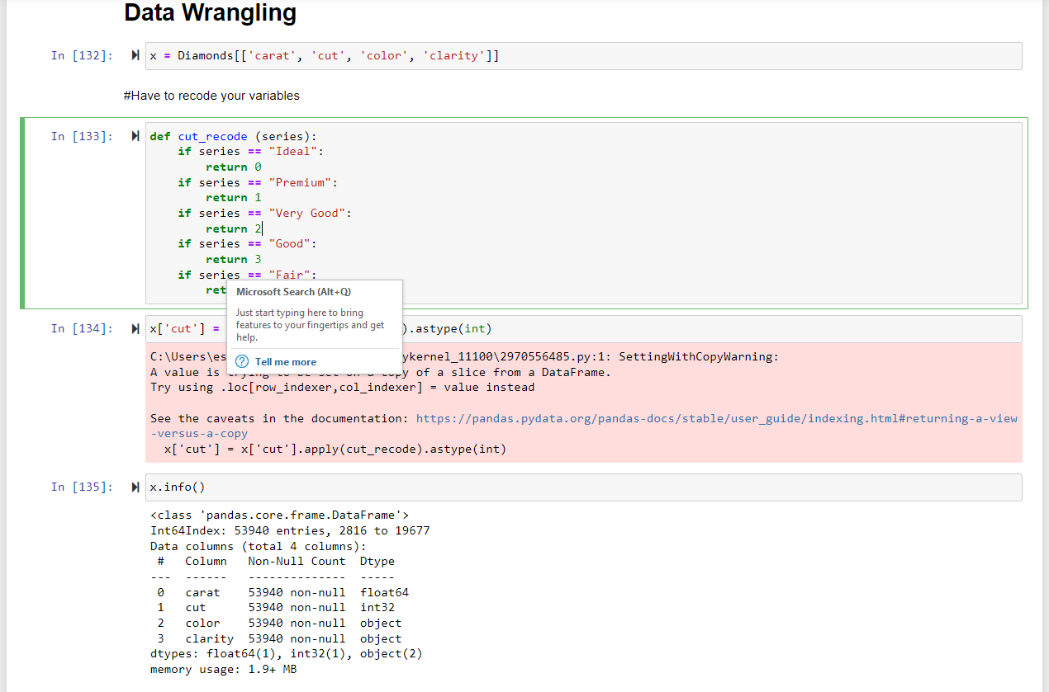
LET’S DO SOME DATA WRANGLING
Recode Those Variables!!!

Slide 6
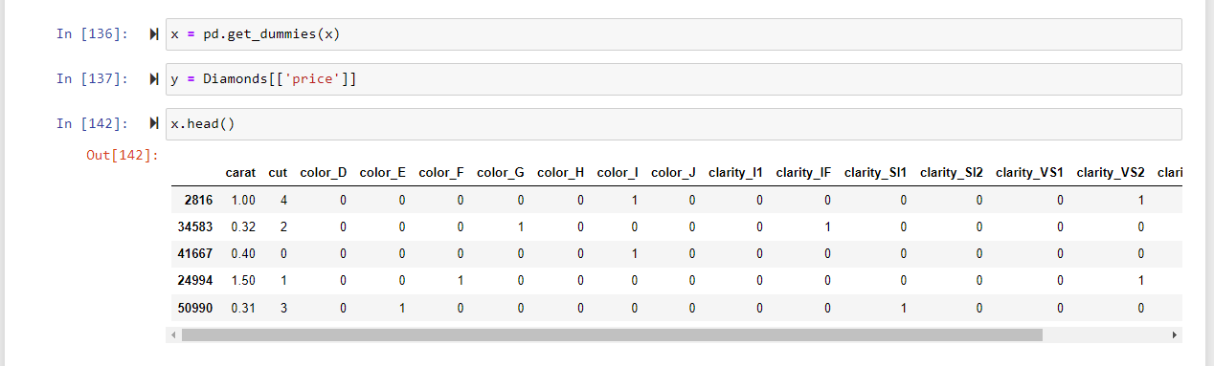
MORE OF THE DATA WRANGLING

Slide 7
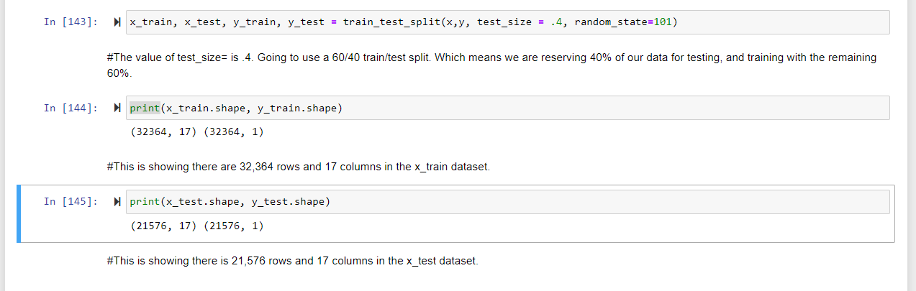
TRAIN_TEST SPLIT
In Train Test Split you split your data in half, and reserve the first chunk for training the model, and the second half for testing the model. How big should a "chunk" be? Typically, you want more data to be used for training than for testing. 80/20, 70/30, and 60/40 splits are all acceptable.
We will be using 60/40 split.

Slide 8
MORE OF THE TRAIN TEST SPLIT()
You will utilize the train_test_split() function from sklearn to split your data. You will end up with four data sets at the end:
x_train
x_test
y_train
y_test
There will be one training dataset and one testing dataset each for x and y.
The train_test_split() function, you will place your x and y data, and specify how much of your data you want to test with the argument test_size=. In this case, the value of test_size= is .4, because you are going to use a 60/40 train/test split. This means that you are reserving 40% of your data for testing, and training with the remaining 60%.

Slide 9
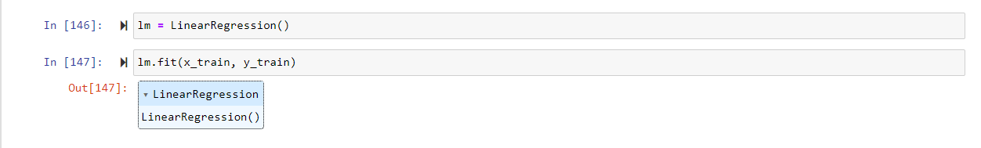
LINEAR REGRESSION MODEL
After you run a train test split you run the linear regression model on your training data.
Linear model has a name of lm.
You will then fit this model to the training data using the .fit() function, specifying the x and y training sets.
If you get a split back to you, then you know it’s worked ok. Do we have a split?

Slide 10
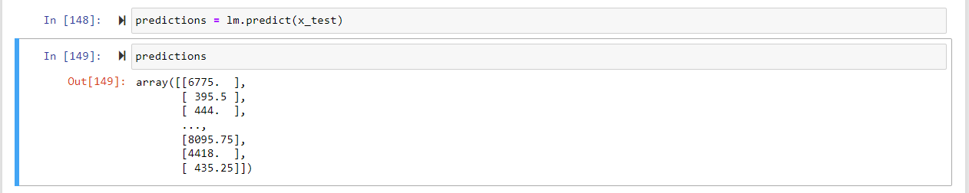
EXAMINE PREDICTIONS
Now you can see the predictions made about diamond prices.

Slide 11
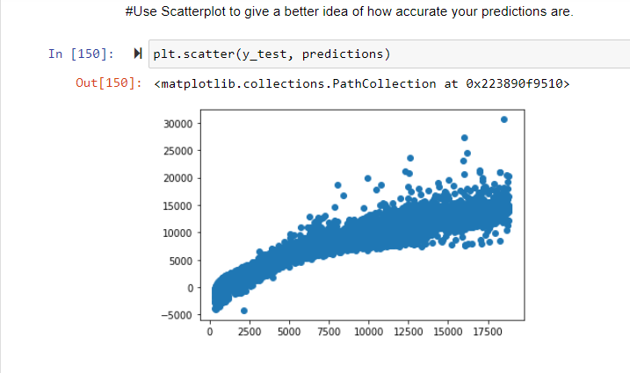
EXAMINE PREDICTIONS
Plotting gives you a better idea of how accurate your predictions are.
The straighter the line, the better the model fit.
Make a scatterplot with the plt.scatter() function, graphing the y_test data against the predictions

Slide 12
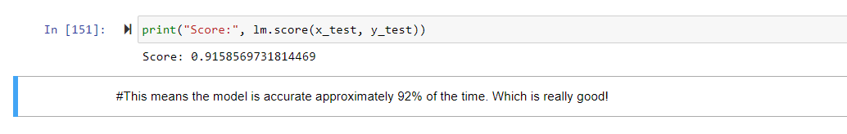
ACCURACY SCORE

Slide 13
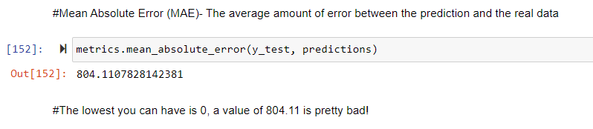
EXAMINING ERROR
Mean Absolute Error (MAE)- The average amount of error between the prediction and the real data.
0 is the lowest value.

Slide 14
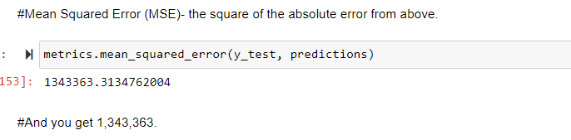
EXAMINING ERROR
Mean Squared Error (MSE)- The square of the absolute error from your MAE

Slide 15
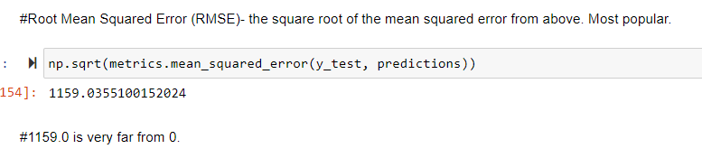
EXAMINING ERROR
Root Mean Squared Error (RMSE)- The square root of the mean squared error from above.
Most popular to use.

Slide 16

CROSS- VALDATION
Goal is to accurately predict diamond prices.
From our findings we found out that…Using the simple code we found out the first and second trained model were accurate 92% of the time and the third trained model was accurate 91% of the time.

Slide 17
THE END

